Slide 1
Programming training (5)
Chun-Yuan Lin

Slide 2
2D Geometric Transformations
Two-Dimensional Composite-Matrix Programming
centroid

Slide 3
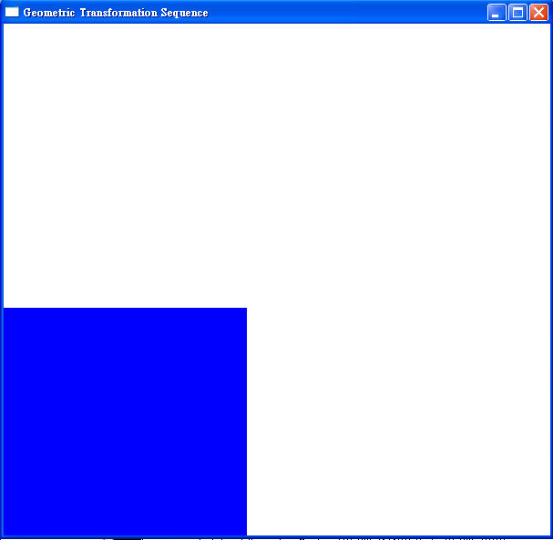
(1)
Initial : Figure 1
Scale: sx: 0.5, sy=0.5, fixedPt: centroid
Rotate: pivPt: centroid, 45∘
Translate: tx: 50, ty:100;
Red color
(2)
Initial: Figure 1
Rotate: pivPt: centroid, 45∘
Translate: tx: -20, ty:50
Scale: sx: 2, sy=0.5, fixedPt: centroid
Rotate: pivPt: centroid, -90∘
Translate: tx: 50, ty:100;
Scale: sx: 2, sy=0.5, fixedPt: centroid
Figure 1

Slide 4
Training homework 5
Please send the Source code file (*.c or *.cpp) to me (cyulin@mail.cgu.edu.tw) before 11/25, 23:59:59.
Please annotate your name and your student ID in email.
  The file name is “student ID”. If more than one files, the names are “student ID-1”, “student ID-2”, etc.
  Please compress the file(s) to a .zip or .rar file. The file name is “student ID-train4”.
  For example, a student has ID “A0000001” and two source code files. The source code file names are A0000001-1.c and A0000001-2.c and the compressed file name is A0000001-train5.zip.
The files will be rejected without following the rules.

